Slide 1
ARP & SECURITY ISSUES
CyberQuince​
Notes:
In this lesson, we explore the security
aspect of ARP. As a matter of fact,
many of the network protocols we
discussed in this course have similar
security flaws as you’ll see in ARP, but
this one is the easiest to understand,
especially for those just starting to
learn about computer networks.
So, what’s the issue with ARP?!

Slide 2
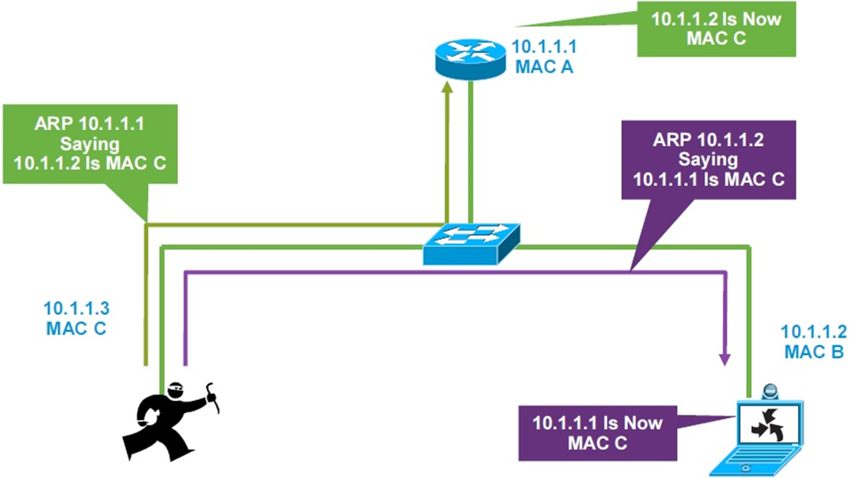
ARP’S PROBLEM
Notes:
Well, one characteristic of ARP that I didn’t
mention yet – and it is fully legal and even
designed that way in ARP’s RFC (Request
for Comment) document – is that, clients
are totally allowed and expected to send
“unsolicited” ARP replies. What exactly does
that mean? You remember that in order for
a network device to learn another devices
MAC address, it will send out an ARP request
saying something like “hey, who has
THIS IP” – and then will list the IP in hopes
that the request will reach that very device
and it will reply with its MAC address.
Now if you’re a malicious actor and not a
legitimate, well-meaning user of the network,
you’ll see instantly how that’s a problem. For
those of us who don’t think like a hacker 24/7,
let me explain with an example.
Let’s look at this picture here. Notice that there’s
device A – the router, device B, the laptop, and
device C – someone who looks like a ninja running
around with some stick. ☺
Joking aside, let’s dive into this example.
So the hacker is MAC C, IP address three.
Router is MAC A, IP address one. And the laptop
is MAC B, IP address two.
The hacker sends both of them an ARP reply
with information that IP two, and IP one,
belong to the device with MAC address C.
MAC address C again – belongs to the hacker
sending these false messages. In essence, he’s
telling them that he is configured with those IP
addresses.

Slide 3
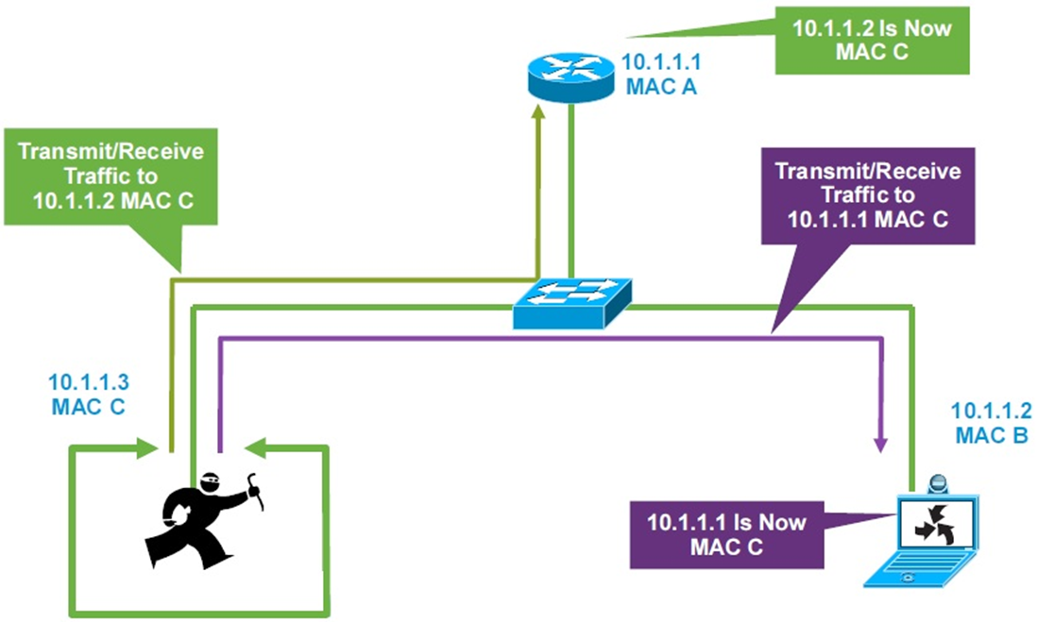
ARP’S PROBLEM
Notes:
All that will result in the following:
Both of those devices that were just
fed wrong information, the router and the
laptop, will send their traffic to the attacker –
with MAC address C, even when they want
to send traffic to the other device. How?
Well, remember that switches use MAC
addresses and not IP addresses? That’s
right, if the laptop wants to send a
message to the router, it will use destination
IP address 10.1.1.1, but in its ARP table, it
will find a wrongful mapping of 10.1.1.1 with
MAC C, and as long as it uses that MAC
address, the packet will end up being sent
to the attacker.

Slide 4
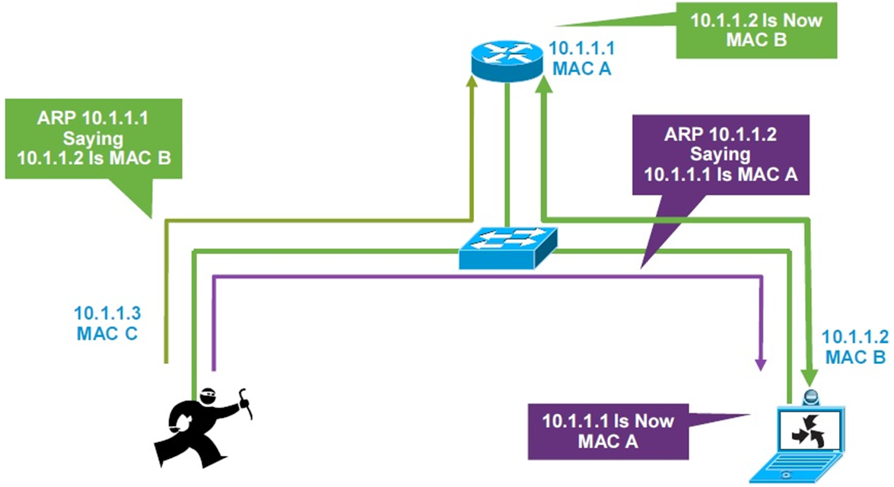
ARP’S PROBLEM
Notes:
Of course, the attacker can use the same
approach in removing evidence, by simply
sending out correct information right after
the damage was done – meaning, right
after he, or she ☺, has scooped all the
wanted information.
Oh, and if you’re wondering what
might solve this issue, don’t worry –
there’s configurations available to help with it.
One of those is DAI, short for Dynamic ARP
inspection, it is a feature that can be configured
on network devices to detect this behavior, and
also set up some sort of remediation, such as
blocking that port where the hacker is suspected
to have connected to, for example.

Slide 5
ARP & SECURITY ISSUES
CyberQuince
Notes:
Alright, this was short (but sweet), my goal
was to make you aware of some of the security
issues which come in hand with these protocols.
Hope it was clear and you found it useful.

